Slide 1
REGRESSION

Slide 2

UNIT III syllabus
Regression:
Introduction to Regression analysis
Measure of linear relationship
Regression with stats models
Determining coefficient
Meaning and significance of coefficients
Coefficient calculation with Least square method
Types of regression:
Simple Linear Regression
Using Multiple features
Polynomial Regression
Metrics for Regression: MSE, RMSE, MAE.

Slide 3
REGRESSION
Regression is the relationship between one dependent variable and a series of other variables (known as independent variables).
It helps to determine: → independent variables, which are playing a significant role in predicting the dependent variable.
Examples:
Prediction of rainfall using temperature and other factors
Price Prediction of a product
Determining Market trends
Prediction of road accidents due to rash driving.

Slide 4
Regression analysis
Regression analysis is a statistical method to model the relationship between a dependent (target) and one or more independent (predictor) variables.
It predicts continuous/real values such as temperature, age, salary, price, etc.

Slide 5
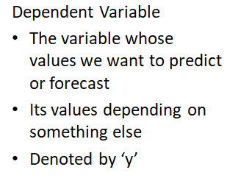
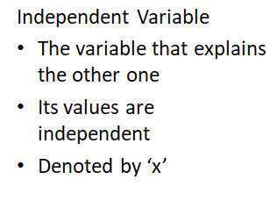
Variable’s Roles..

Slide 6
understanding the concept of regression analysis using example
Example: Data is found for hours of sunshine vs how many ice creams were sold at the shop from Monday to Friday:
"x" Hours of Sunshine | "y" Ice Creams Sold
2 | 4
3 | 5
5 | 7
7 | 10
8 | ???
9 | 15

Slide 7
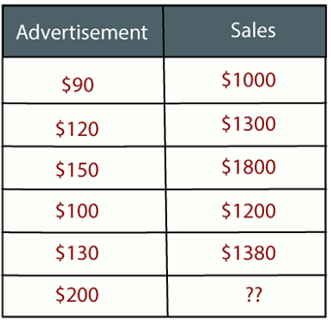
Example: There is a marketing company A, who does various advertisement every year and get sales on that. The below list shows the amount spend on advertisement made by the company in the last 5 years and the corresponding sales:
Now, the company wants to do the advertisement of $200 in the year 2022 and wants to know the prediction about the sales for this year. To solve such type of prediction problems in machine learning, we need regression analysis.

Slide 8
Regression
Dependent variable (Y)
Independent variable (x)
Regression is thus an explanation of causation.
If the independent variable(s) sufficiently explain the variation in the dependent variable, the model can be used for prediction.

Slide 9
Why do we use Regression Analysis?
Regression analysis helps in the prediction of a continuous variable.
Some Real world examples are
weather condition
sales prediction
marketing trends, etc.,
Regression estimates the relationship between the target and the independent variable.
By performing the regression, we can confidently determine the most important factor, the least important factor, and how each factor is affecting the other factors.

Slide 10
Measure of Linear Relationship
statistical measures show a relationship between two or more variables or two or more sets of data.
The major statistical measure of relationship is the correlation coefficient.

Slide 11
Calculating How Well The Regression Line Fits
To determine how well our regression line fits the data, we need to calculate the correlation coefficient, commonly referred to just as R, and the coefficient of determination, otherwise known as R² (R squared).

Slide 12

Correlation Coefficient (R)
The degree of relationship or correlation between two variables (x and y in this case). R can range from -1 to 1 with values equal to 1 meaning a perfect positive correlation and values equal to -1 meaning a perfect negative correlation

Slide 13
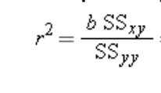
Coefficient of Determination (R²)
The percentage of variance explained by the independent variable (x) with values between 0 and 1.
It cannot be negative because it is a square value.
For example, if R² = 0.81, then this tells you that x explains 81% of the variance in y. Otherwise known as the “goodness of fit”.

Slide 14
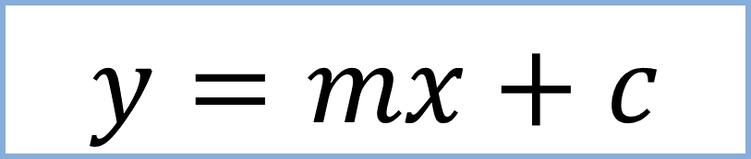
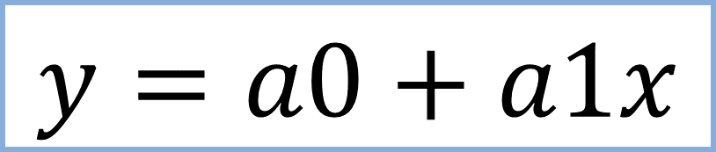
Measure of Linear Relationship
Lets Consider the Equation of a Straight-line
where m is the slope of the line, c is a constant
Independent Variable
Dependent Variable
constant
Coefficient

Slide 15
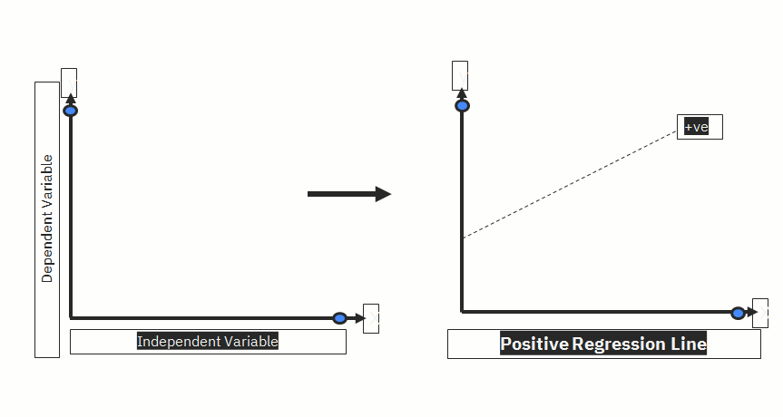
Measure of Linear Relationship

Slide 16
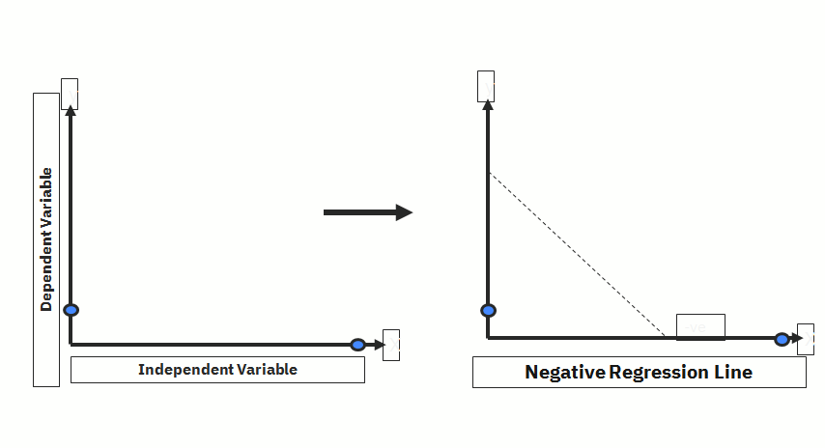
Measure of Linear Relationship

Slide 17
Least Square Method
The least-squares method is a crucial statistical method that is practiced to find a regression line or a best-fit line for the given pattern or Data. This method is described by an equation with specific parameters.
Best-fit line: Line of best fit refers to a line through a scatter plot of data points that best expresses the relationship between dependent & independent variables.

Slide 18
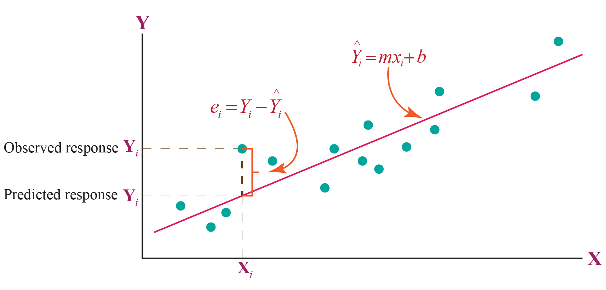
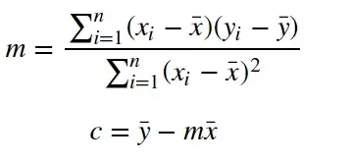
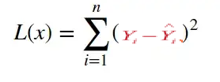
Coefficient Calculation with Least Square Method
Equation of St.Line:Y=mx+c
Coefficient Calculation
Error=

Slide 19
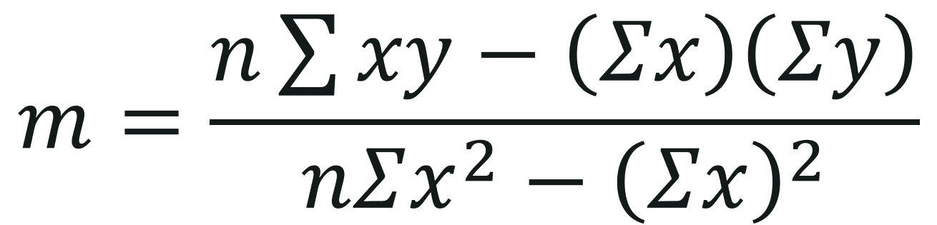
Coefficient Calculation with Least Square Method
Equation of St.Line:Y=mx+c+e
Error=
Least Squares Error method determines the values of m and c, that gives the minimum error for the given dataset.
c = (∑y - m∑x)/n

Slide 20
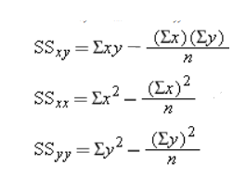


Coefficient Calculation with Least Square Method
Step 1: For each (x,y) point calculate x² and xy.
Step 2: Sum all x, y, x² and xy, which gives us Σx, Σy, Σx² and Σxy
Step 3: Calculate Slope m:
Step 4: Calculate Intercept b:
if y = a+bx
Step 5: Assemble the equation of a line

Slide 21
Example: Data is found for hours of sunshine vs how many ice creams were sold at the shop from Monday to Friday:
"x" Hours of Sunshine | "y" Ice Creams Sold
2 | 4
3 | 5
5 | 7
7 | 10
8 | ???
9 | 15

Slide 22
Step 1: For each (x,y) calculate x² and xy:
x | y | x² | xy
2 | 4 | 4 | 8
3 | 5 | 9 | 15
5 | 7 | 25 | 35
7 | 10 | 49 | 70
9 | 15 | 81 | 135

Slide 23
Step 2: Sum x, y, x² and xy (gives us Σx, Σy, Σx² and Σxy):
x | y | x² | xy
2 | 4 | 4 | 8
3 | 5 | 9 | 15
5 | 7 | 25 | 35
7 | 10 | 49 | 70
9 | 15 | 81 | 135
Σx: 26 | Σy: 41 | Σx²: 168 | Σxy: 263

Slide 24
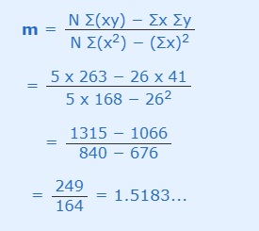
Step 3: Calculate Slope m:

Slide 25
Step 4: Calculate Intercept b:

Slide 26
weather forecast which says "we expect 8 hours of sun tomorrow", so the above equation to estimates, he will sell. y = 1.518 x 8 + 0.305 = 12.45 Ice Creams
Step 5: Assemble the equation of a line:

Slide 27
# Function to find the least regression line
def leastRegLine(X,Y,n):
# Finding b
b = calculateB(X, Y, n)
meanX = (sum(X)/n)
meanY = (sum(Y)/n)
# Calculating a
a = meanY - b * meanX
# Printing regression line
print("Regression line:")
print("Y = ", '%.3f'%a, " + ", '%.3f'%b, "*X", sep="")
# Driver code
# Statistical data
X = [2, 3, 5, 7, 9 ]
Y = [4, 5, 7, 10,15]
n = len(X)
leastRegLine(X, Y, n)
# Python program to find the regression line
# Function to calculate b
def calculateB(x, y, n):
# sum of array x
sx = sum(x)
# sum of array y
sy = sum(y)
# for sum of product of x and y
sxsy = 0
# sum of square of x
sx2 = 0
for i in range(n):
sxsy += x[i] * y[i]
sx2 += x[i] * x[i]
b = (n * sxsy - sx * sy)/(n * sx2 - sx * sx)
return b

Slide 28
Coefficient Calculation with Least Square Method
Following are the steps to calculate the least square using the formulas:
Step 1: Draw a table with 4 columns where the first two columns are for x and y points.
Step 2: In the next two columns, find xy and (x)².
Step 3: Find ∑x, ∑y, ∑xy, and ∑(x)².
Step 4: Find the value of slope m using the above formula.
Step 5: Calculate the value of b using the above formula.
Step 6: Substitute the value of m and b in the equation y = mx + c

Slide 29
Example: Let's say we have data as shown below.
R²
Calculate the Correlation coefficient (R) and Determinant of coefficient of given data:
x | 1 | 2 | 3 | 4 | 5
y | 2 | 5 | 3 | 8 | 7

Slide 30
Solution:
Find the value of m by using the formula,
m = (n∑xy - ∑y∑x)/n∑x² - (∑x)²
m = [(5×88) - (15×25)]/(5×55) - (15)²
m = (440 - 375)/(275 - 225)
m = 65/50 = 13/10=1.3
Find the value of c by using the formula,
c = (∑y - m∑x)/n
c = (25 - 1.3×15)/5
c = (25 - 19.5)/5
c = 5.5/5=1.1
So, the required equation of least squares is y = mx + c = 1.3x + 1.1.
x | y | xy | x²
1 | 2 | 2 | 1
2 | 5 | 10 | 4
3 | 3 | 9 | 9
4 | 8 | 32 | 16
5 | 7 | 35 | 25
∑x =15 | ∑y = 25 | ∑xy = 88 | ∑x² = 55

Slide 31
# Function to find the least regression line
def leastRegLine(X,Y,n):
# Finding b
b = calculateB(X, Y, n)
meanX = (sum(X)/n)
meanY = (sum(Y)/n)
# Calculating a
a = meanY - b * meanX
# Printing regression line
print("Regression line:")
print("Y = ", '%.3f'%a, " + ", '%.3f'%b, "*X", sep="")
# Driver code
# Statistical data
X = [1, 2, 3, 4, 5 ]
Y = [2, 5, 3, 8,7]
n = len(X)
leastRegLine(X, Y, n)
# Python program to find the regression line
# Function to calculate b
def calculateB(x, y, n):
# sum of array x
sx = sum(x)
# sum of array y
sy = sum(y)
# for sum of product of x and y
sxsy = 0
# sum of square of x
sx2 = 0
for i in range(n):
sxsy += x[i] * y[i]
sx2 += x[i] * x[i]
b = (n * sxsy - sx * sy)/(n * sx2 - sx * sx)
return b

Slide 32
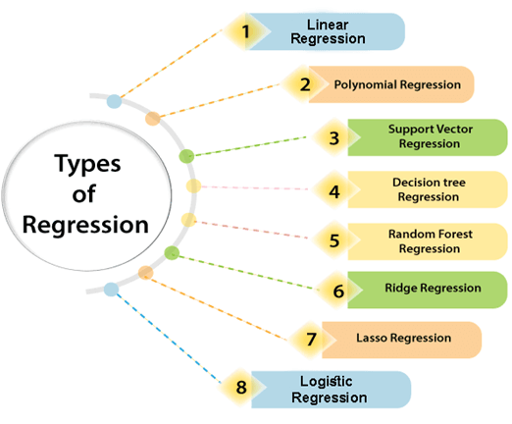
Types of Regression Analysis Techniques

Slide 33
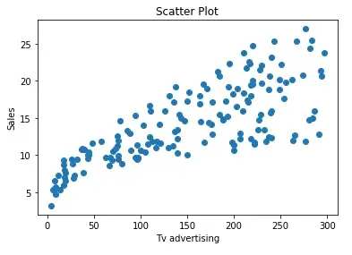
Assumptions Of Linear Regression Algorithm
Regression is a parametric approach. ‘Parametric’ means it makes assumptions about data for the purpose of analysis.
Due to its parametric side, regression is restrictive in nature.
It fails to deliver good results with data sets which doesn’t fulfill its assumptions. Therefore, for a successful regression analysis, it’s essential to validate these assumptions.
5 basic assumptions of Linear Regression Algorithm:
1. Linear Relationship between the features and target:
According to this assumption there is linear relationship between the features and target.
This can be validated by plotting a scatter plot between the features and the target.

Slide 34
2.Normal distribution of Data:
Normal Distribution is backbone of Machine Learning. A Data Scientist needs to know about Normal Distribution of data when they work with Linear Models.
Linear Models perform well if the data is normally distributed.
The normal distribution carries with it assumptions and can be completely specified by two parameters: the mean and the standard deviation. If the mean and standard deviation are known, you can access every data point on the curve.
The empirical rule is a handy quick estimate of the data's spread given the mean and standard deviation of a data set that follows a normal distribution. It states that:
68.26% of the data will fall within 1 sd of the mean(μ±1σ)
95.44% of the data will fall within 2 sd of the mean(μ±2σ)
99.7% of the data will fall within 3 sd of the mean(μ±3σ)

Slide 35
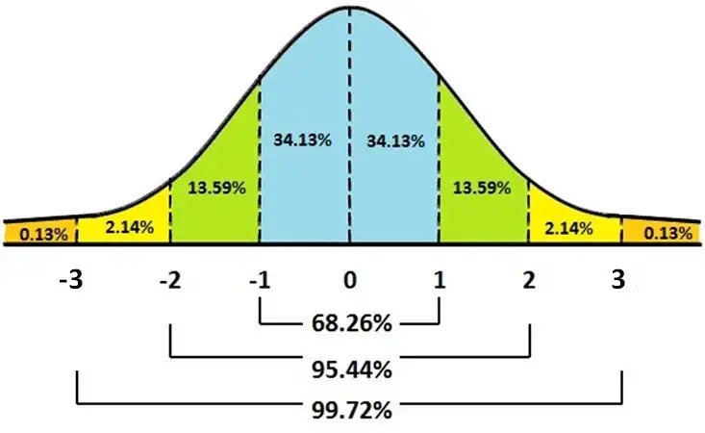

Slide 36
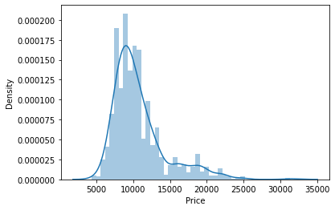
This can be validated by plotting a Dist plot of the features.
Dist Plot
sns.distplot(toyotadf['Price'])

Slide 37
3.Little or No Multicollinearity between independent variables/features
Multicollinearity: It is a state of very high inter-correlations or inter-associations among the independent variables.
If a model have more multicollinear variables, it becomes a tough task to figure out the true relationship of a predictors with response variable. In other words, it becomes difficult to find out which variable is actually contributing to predict the response variable.
Pair plots and heat maps (correlation matrix) can be used for identifying highly correlated features.
How multicollinearity can be treated?
If we have 2 features which are highly correlated we can drop one feature or combine the 2 features to form a new feature,which can further be used for prediction.

Slide 38
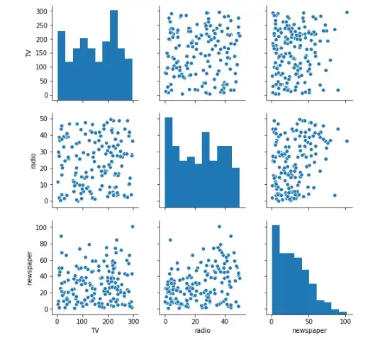
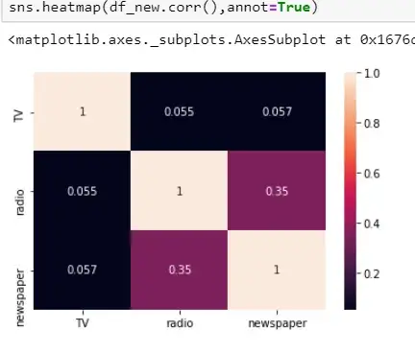
Pair plot
Heat Map

Slide 39

4.Little or No autocorrelation in the residuals:
Autocorrelation occurs when the residual errors are dependent on each other.
The presence of correlation in error terms drastically reduces model’s accuracy.
This usually occurs in time series models where the next instant is dependent on previous instant.
Autocorrelation can be tested with the help of Durbin-Watson test.The null hypothesis of the test is that there is no serial correlation. The Durbin-Watson test statistics is defined as:

Slide 40
The test statistic is approximately equal to 2*(1-r) where r is the sample autocorrelation of the residuals.
Thus, for r == 0, indicating no serial correlation, the test statistic equals 2. This statistic will always be between 0 and 4.
The closer to 0 the statistic, the more evidence for positive serial correlation. The closer to 4, the more evidence for negative serial correlation.
5.Homoscedasticity Assumption:
Homoscedasticity describes a situation in which the error term (that is, the “noise” or random disturbance in the relationship between the features and the target) is the same across all values of the independent variables.
A scatter plot of residual values vs predicted values is a goodway to check for homoscedasticity.
There should be no clear pattern in the distribution and if there is a specific pattern,the data is heteroscedastic.

Slide 41
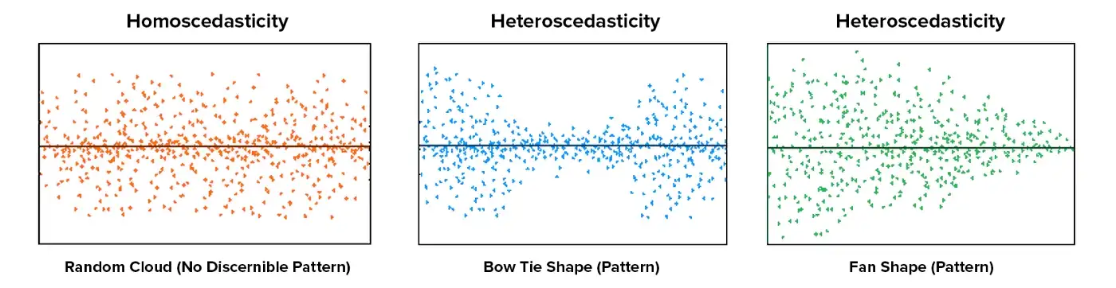
The leftmost graph shows no definite pattern i.e constant variance among the residuals, the middle graph shows a specific pattern where the error increases and then decreases with the predicted values violating the constant variance rule and the rightmost graph also exhibits a specific pattern where the error decreases with the predicted values depicting heteroscedasticity

Slide 42
Linear Regression
Linear regression is a statistical regression method which is used for predictive analysis.
It is one of the very simple and easy algorithms which works on regression and shows the relationship between the continuous variables.
If there is only one input variable (x), then such linear regression is called simple linear regression or univariate linear regression.

Slide 43
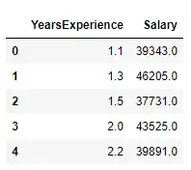
Example: Let us consider a example wherein we are predicting the salary a person given the years of experience he/she has in a particular field. The data set is shown below

Slide 44
Linear Regression

Slide 45
Linear Regression
y= a0 + a1 * X
Salary
Salary= a0 + a1 * Experience
Experience

Slide 46
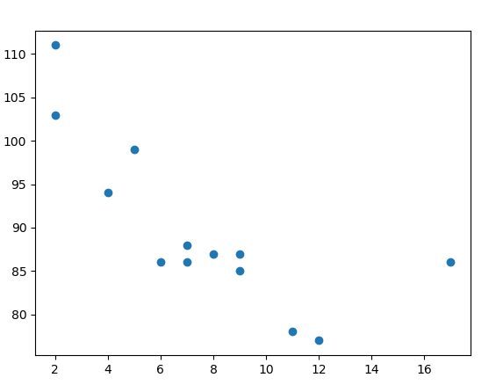
How Does it Work with Python?
Python has methods for finding a relationship between data-points and to draw a line of linear regression. We will show you how to use these methods instead of going through the mathematical formula.
In the example below, the x-axis represents age, and the y-axis represents speed. We have registered the age and speed of 13 cars as they were passing a tollbooth. Let us see if the data we collected could be used in a linear regression:
Example
Start by drawing a scatter plot:
import matplotlib.pyplot as plt x = [5,7,8,7,2,17,2,9,4,11,12,9,6] y = [99,86,87,88,111,86,103,87,94,78,77,85,86] plt.scatter(x, y) plt.show()

Slide 47
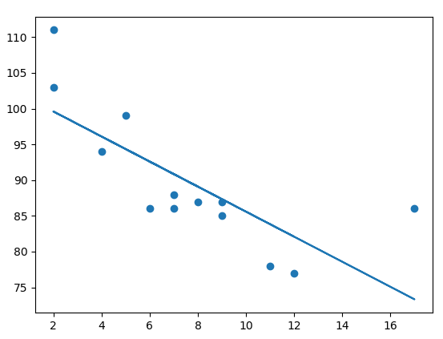
import matplotlib.pyplot as plt from scipy import stats x = [5,7,8,7,2,17,2,9,4,11,12,9,6] y = [99,86,87,88,111,86,103,87,94,78,77,85,86] slope, intercept, r, p, std_err = stats.linregress(x, y) def myfunc(x): return slope * x + intercept mymodel = list(map(myfunc, x)) plt.scatter(x, y) plt.plot(x, mymodel) plt.show()

Slide 48
Linear Regression Real Life Examples:
Businesses often use linear regression to understand the relationship between advertising spending and revenue.
Medical researchers often use linear regression to understand the relationship between drug dosage and blood pressure of patients.
Agricultural scientists often use linear regression to measure the effect of fertilizer and water on crop yields.
Data scientists for professional sports teams often use linear regression to measure the effect that different training regimens have on player performance.

Slide 49
Advantages:
Linear Regression is simple to implement and easier to interpret the output coefficients.
When you know the relationship between the independent and dependent variable have a linear relationship, this algorithm is the best to use because of it’s less complexity to compared to other algorithms.

Slide 50
IMPLEMENTING LINEAR REGRESSION ON A REAL TIME DATASET

Slide 51
ABOUT DATASET
This dataset contains information about used cars listed on www.cardekho.com This data can be used for a lot of purposes such as price prediction to exemplify the use of linear regression in Machine Learning. The columns in the given dataset is as follows:
Car_Name
Year
Selling_Price
Present_Price
Kms_Driven
Fuel_Type
Seller_Type
Transmission
Owner

Slide 52
STEPS TO PERFORM REGRESSION ANALYSIS
Step#1 Importing the required libraries
Step#2 Loading the dataset
Step#3 check for any missing or NA values in the training and testing data set
Step#4 check for useful descriptive statistical values
Step#5 define dependent and independent variable for training and testing data
Step#6 define the model and fit it. Step#7 look at different parameters of the model summary and interpret it:
Step#8 define final regression equation using model output parameters.
Step#9: visualize the regression equation fitment on the data.
Step#10: Scatter plot visualization of actual values of dependent variable vs the predicted value.
Step#11: Final step to visualize the Model performance against various well-established evaluation metrics

Slide 53
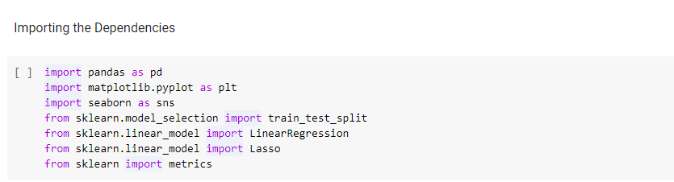
IMPORTING REQUIRED LIBRARIES

Slide 54
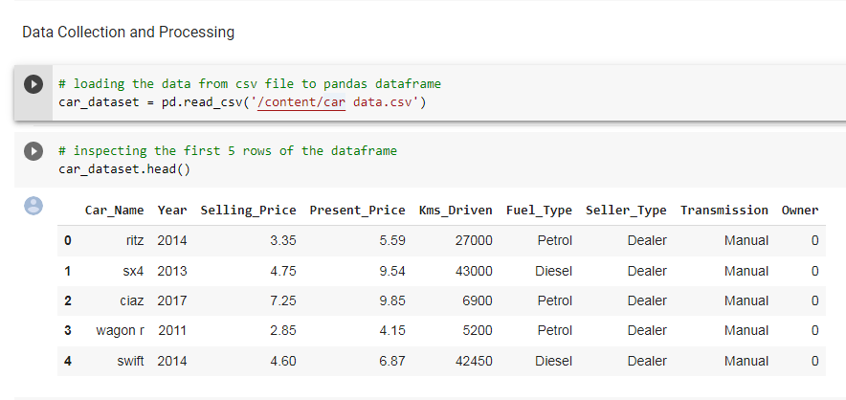

Slide 55
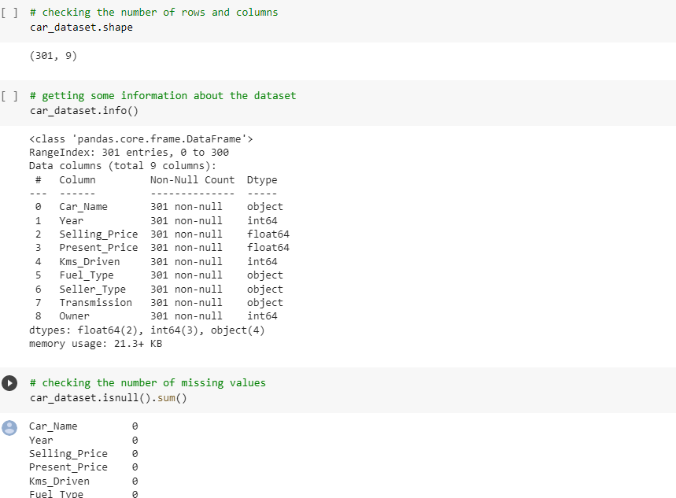
SIZE AND INFORMATION ABOUT DATASET

Slide 56
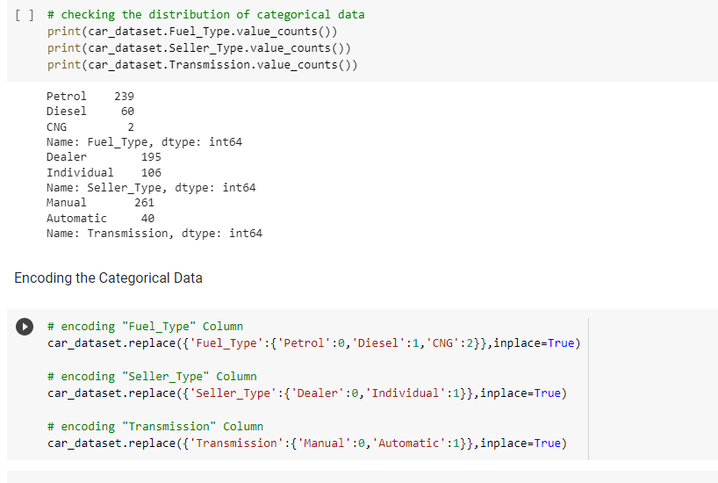

Slide 57
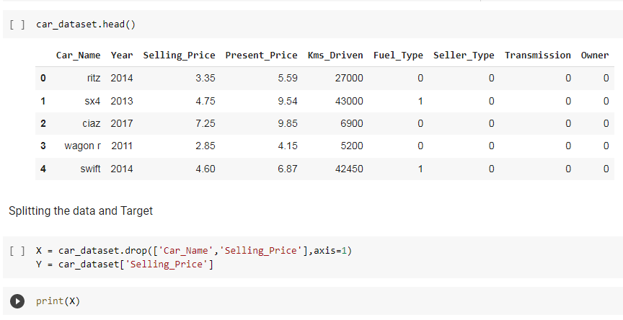

Slide 58
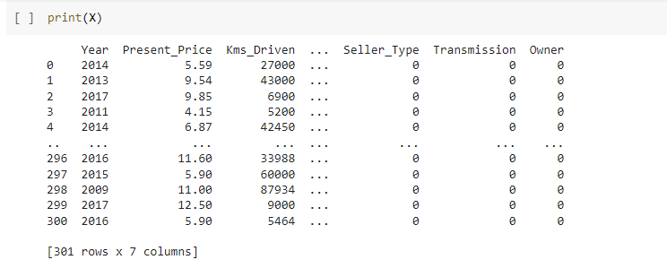

Slide 59
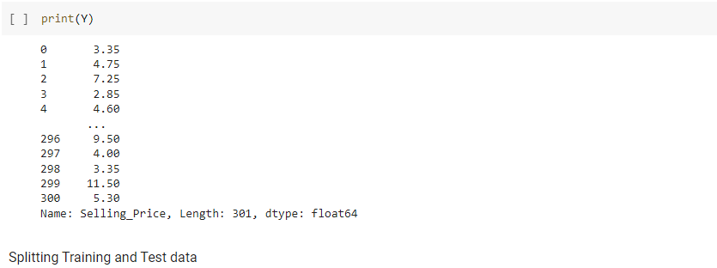

Slide 60
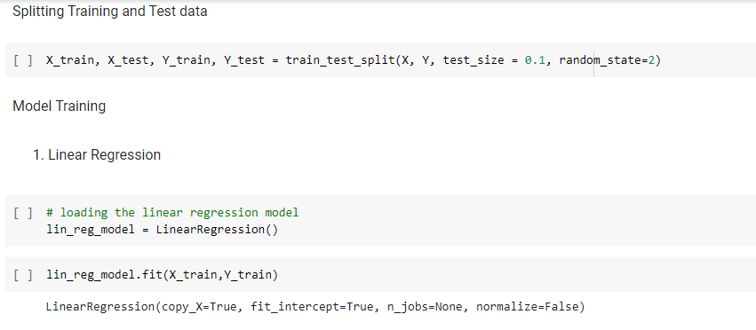

Slide 61
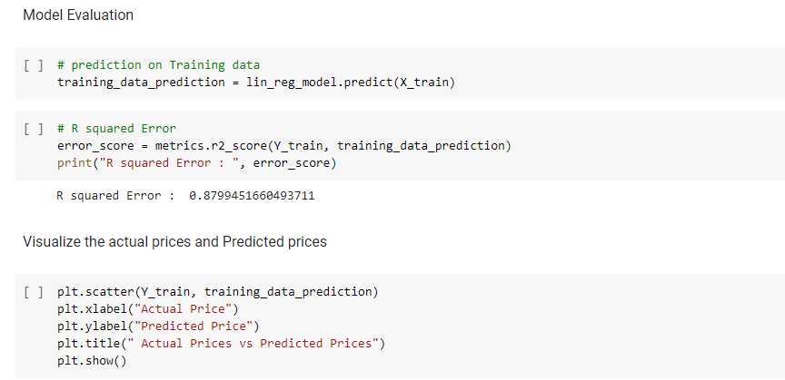

Slide 62
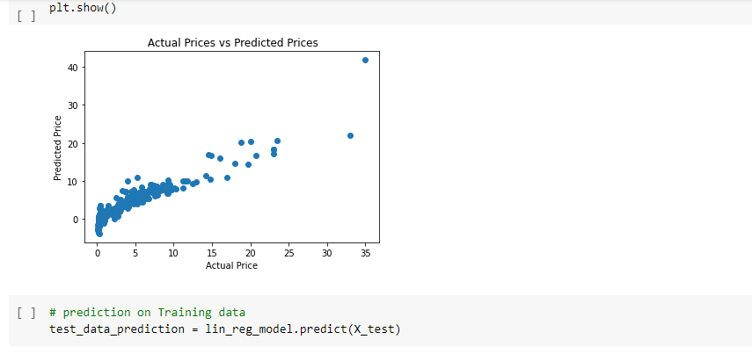

Slide 63
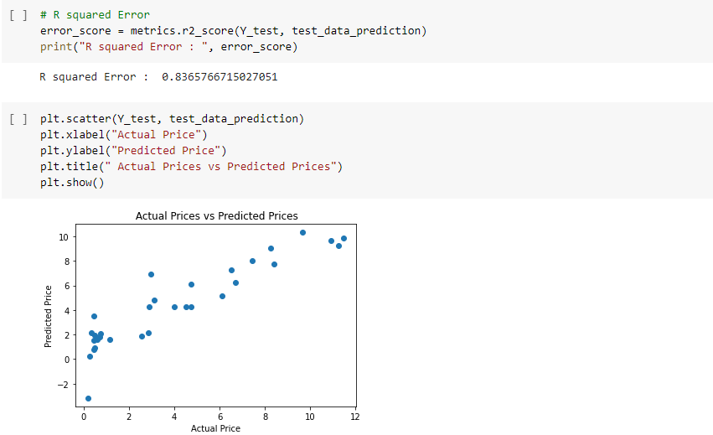

Slide 64
Multi Linear Regression
Multi Linear Regression is one of the important regression algorithms which models the linear relationship between a single dependent continuous variable and more than one independent variable.
Multi Linear Regression equation:
y= b₀+b₁x+ b₂x₂+ b₃x₃+....+ b_{n}x_{n}

Slide 65
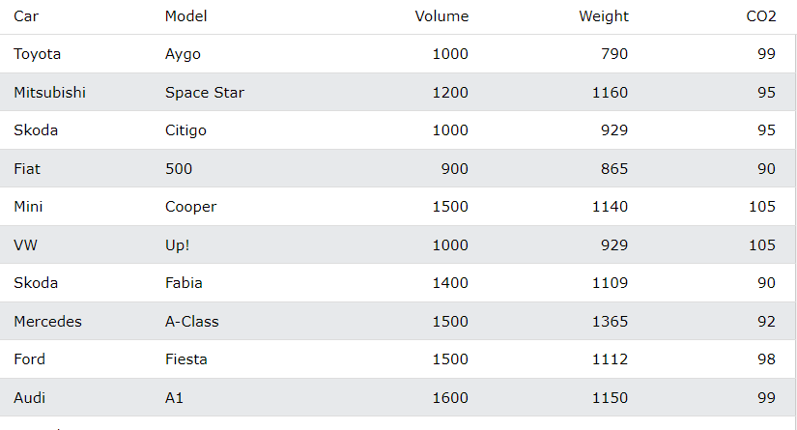
Multiple Regression
Take a look at the data set below, it contains some information about cars.
We can predict the CO2 emission of a car based on the size of the engine, but with multiple regression we can throw in more variables, like the weight of the car, to make the prediction more accurate.

Slide 66
How Does it Work?
[107.2087328]
[107.2087328]
[107.2087328]
import pandas from sklearn import linear_model df = pandas.read_csv("data.csv") X = df[['Weight', 'Volume']] y = df['CO2'] regr = linear_model.LinearRegression() regr.fit(X, y) #predict the CO2 emission of a car where the weight is 2300kg, and the volume is 1300cm³: predictedCO2 = regr.predict([[2300, 1300]]) print(predictedCO2)
Result:107.2087328

Slide 67
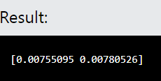
Print the coefficient values of the regression object:
import pandas from sklearn import linear_model df = pandas.read_csv("data.csv") X = df[['Weight', 'Volume']] y = df['CO2'] regr = linear_model.LinearRegression() regr.fit(X, y) print(regr.coef_)

Slide 68
Polynomial Regression

Slide 69
Polynomial Regression
Polynomial Regression is a regression algorithm that models the relationship between a dependent(y) and independent variable(x) as nth degree polynomial.
The Polynomial Regression equation is given below:
y= b₀+b₁x + b₂x²+ b₃x³+....+ b_{n}x^{n}
when data points are in a non-linear, Polynomial Regression model can be implemented.
it is also called the special case of Multiple Linear Regression in ML. Because we add some polynomial terms to the Multiple Linear regression equation to convert it into Polynomial Regression.
It makes use of a linear regression model to fit the complicated and non-linear functions and datasets.
Hence, "In Polynomial regression, the original features are converted into Polynomial features of required degree (2,3,..,n) and then modeled using a linear model.

Slide 70
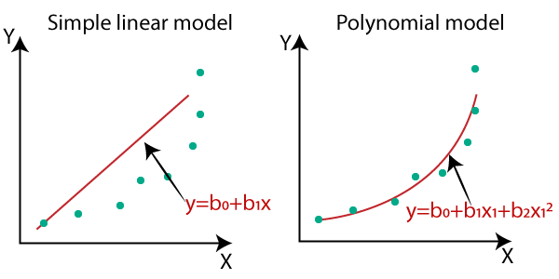

Slide 71
How Does it Work?
In the example below, we have registered 18 cars as they were passing a certain tollbooth.
We have registered the car's speed, and the time of day (hour) the passing occurred.
The x-axis represents the hours of the day and the y-axis represents the speed:
Start by drawing a scatter plot:

Slide 72
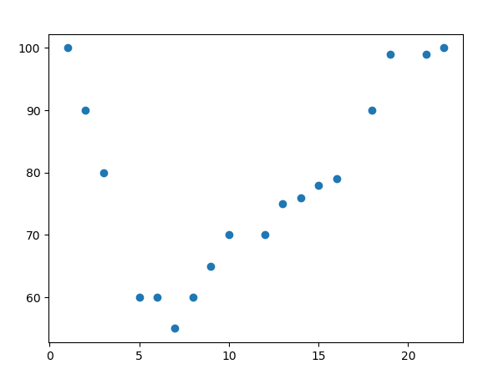
import matplotlib.pyplot as plt x = [1,2,3,5,6,7,8,9,10,12,13,14,15,16,18,19,21,22] y=[100,90,80,60,60,55,60,65,70,70,75,76,78,79,90,99,99,100] plt.scatter(x, y) plt.show()

Slide 73
Example Import numpy and matplotlib then draw the line of Polynomial Regression:
import numpy import matplotlib.pyplot as plt x = [1,2,3,5,6,7,8,9,10,12,13,14,15,16,18,19,21,22] y = [100,90,80,60,60,55,60,65,70,70,75,76,78,79,90,99,99,100] mymodel = numpy.poly1d(numpy.polyfit(x, y, 3)) myline = numpy.linspace(1, 22, 100) plt.scatter(x, y) plt.plot(myline, mymodel(myline)) plt.show()

Slide 74
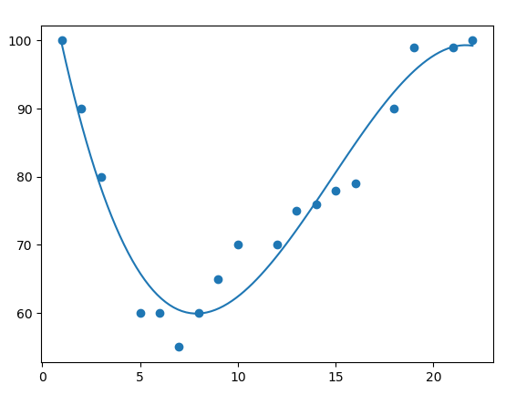
Result

Slide 75
METRICS FOR REGRESSION
The various metrics used to evaluate the results of the prediction are :
Mean Squared Error(MSE)
Root-Mean-Squared-Error(RMSE).
Mean-Absolute-Error(MAE).
R² or Coefficient of Determination.
Adjusted R²

Slide 76
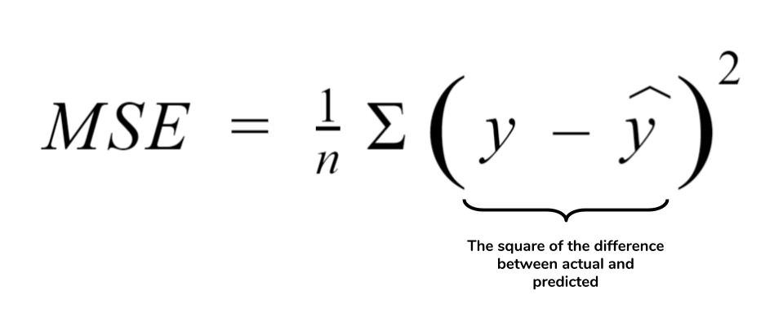
Mean Squared Error
Mean Squared Error: MSE or Mean Squared Error is one of the most preferred metrics for regression tasks. It is simply the average of the squared difference between the target value and the value predicted by the regression model.
As it squares the differences, it penalizes even a small error which leads to over-estimation of how bad the model is.

Slide 77
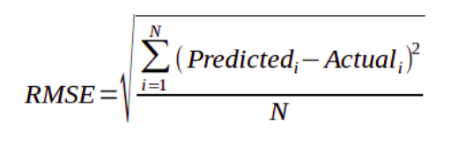
Root Mean Squared Error
Root Mean Squared Error: RMSE is the most widely used metric for regression tasks and is the square root of the averaged squared difference between the target value and the value predicted by the model. It is preferred more in some cases because the errors are first squared before averaging which poses a high penalty on large errors. This implies that RMSE is useful when large errors are undesired.

Slide 78
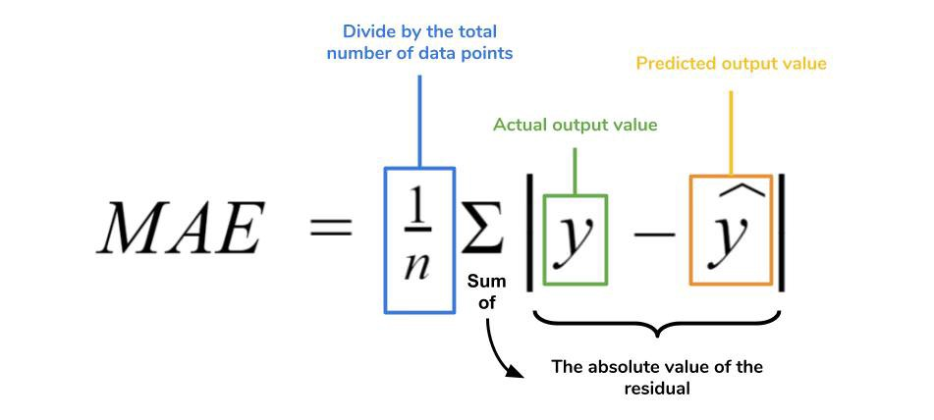
Mean Absolute Error
Mean Absolute Error: MAE is the absolute difference between the target value and the value predicted by the model. The MAE is more robust to outliers and does not penalize the errors as extremely as MSE. MAE is a linear score which means all the individual differences are weighted equally. It is not suitable for applications where you want to pay more attention to the outliers.

Slide 79
Generalization, Overfitting and Underfitting
The ultimate objective of Machine learning and Data Science is to develop models capable of delivering accurate predictions and valuable insights when confronted with new and unseen data.
To achieve this objective, the concept of generalization plays a vital role.
Generalization
Definition: Generalization is the model's ability to perform well on new unseen data after being trained on a given dataset. A well-generalized model learns patterns in the training data that are relevant to the larger data distribution, allowing it to make accurate predictions on data it hasn’t seen.

Slide 80
Importance: Achieving good generalization is essential in machine learning because it enables models to handle real-world scenarios accurately.
Influence Factors: Generalization is influenced by the complexity of the model, the amount and quality of data, and the regularization techniques used.
Example:
A spam email classifier is a great example of generalization in machine learning. Suppose you have a training dataset containing emails labeled as either spam or not spam and your goal is to build a model that can accurately classify incoming emails as spam or legitimate based on their content.

Slide 81
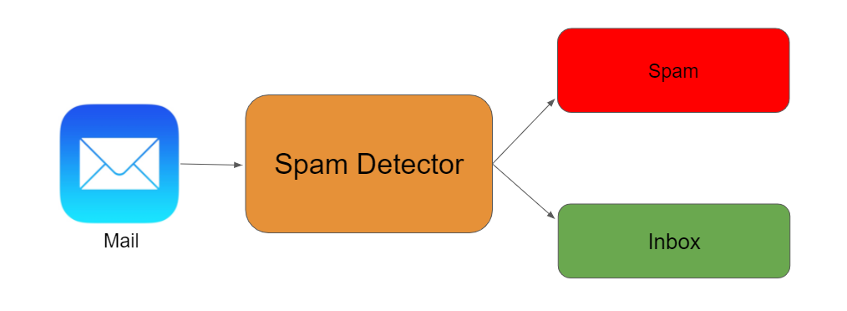

Slide 83
OVERFITTING
Definition:
Overfitting occurs when a model that performs well on the training data but poorly on unseen data because it has memorized specifics rather than generalizing the patterns.
Indicators:
• High accuracy on training data but low accuracy on validation/test data.
Causes:
Complex models with too many parameters (e.g., deep neural networks). • Small training datasets with insufficient diversity.

Slide 84
SOLUTIONS FOR OVERFITTING
Regularization: Techniques like L1, L2 regularization penalize large weights, encouraging simpler models.
Pruning: Removing redundant parts of the model architecture, particularly for decision trees or neural networks.
Cross-validation: Using techniques like k-fold cross-validation to better evaluate model performance.
Early Stopping: Ending the training process when validation error starts increasing.
Ensembling: Combining multiple models

Slide 85
UNDERFITTING
Definition: Underfitting occurs when a model is too simplistic to capture the underlying structure of the data. It fails to fit the training data and, as a result, also performs poorly on new data.
Indicators:
Low accuracy on both training and validation/test datasets.
Causes:
Models that are too simple (e.g., linear regression for non-linear data).
Insufficient training time.
Lack of relevant features in the data.

Slide 86
Solutions for underfitting
Model Complexity: Use more complex models that can capture patterns (e.g., neural networks, ensemble methods).
Feature Engineering: Add or transform features to make patterns more accessible.
Increasing Training Time: Train the model longer to allow it to learn complex patterns.
Hyperparameter Tuning: Adjust parameters to allow for a more flexible fit to the data.
Increasing Data Quality/Quantity: More or better-quality data can help the model learn more about the true data distribution.

